Slide 1

B.Tech Project Evaluation-2 Sub-Classifying Lung Cancer using CNN
Presented by :-
Prince Bhardwaj, 2018013267
Lalawmpuia, 2019003189
Priyam Rastogi, 2018004047
Rasik Dev Rathour, 2018004438
Under the Supervision of:-
Dr. Rajendra Kumar
Sharda University,
Gr. Noida
DEPARTMENT OF COMPUTER SCIENCE & ENGINEERING
SCHOOL OF ENGINEERING AND TECHNOLOGY
02,April 2022

Slide 2
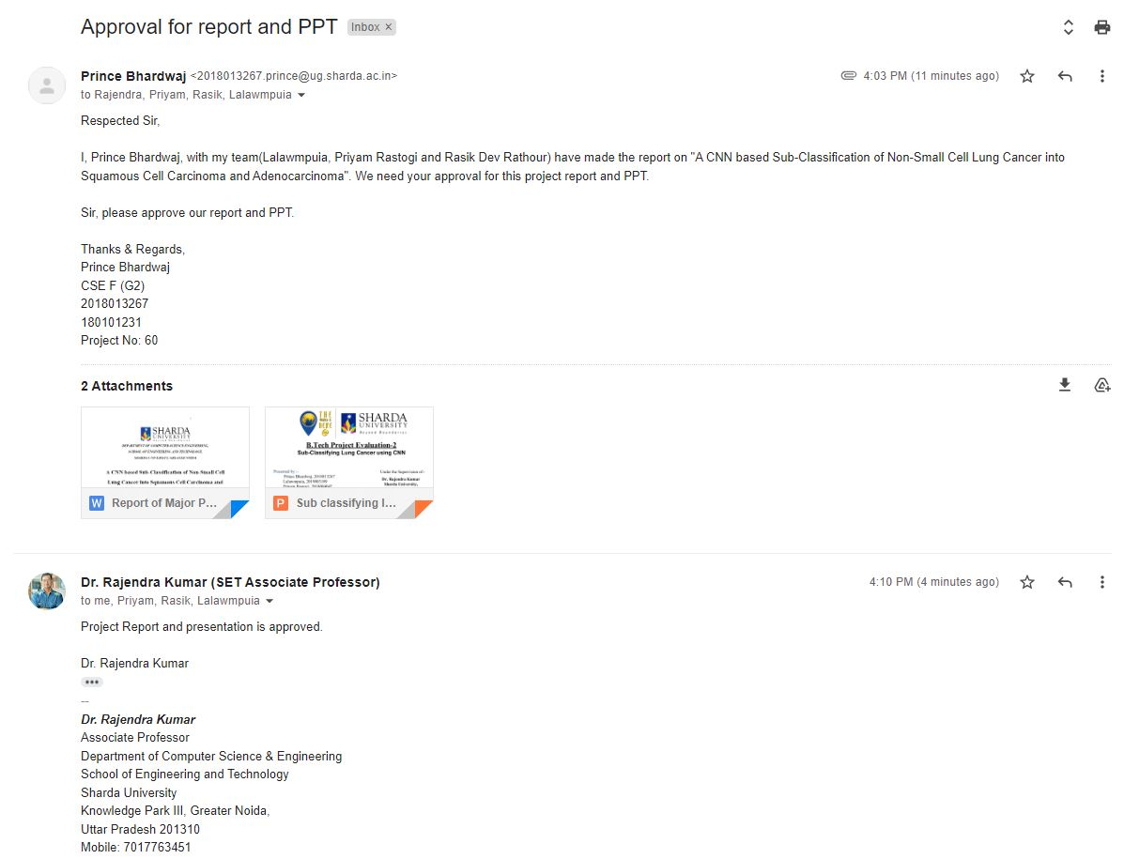
Approval from guide for the evaluation

Slide 3
Contents:
Project Overview
Workload Distribution of the team
Improvement/Work done from the last evaluation
Proof of paper accepted or communicated
Motivation to research problem
Technical Requirements
Working/Methodology
Current Status
Conclusion
References

Slide 4
Project Overview
Cancer is now becoming the most common disease and Lung cancer is the major cause of cancer death in the world.
It is difficult to identify because it appears and manifests symptoms only at the end of the process. Early discovery and treatment of the condition, on the other hand, can minimize the mortality rate and probability.
Approximately 7.6 million people worldwide die each year from lung cancer, according to the World Health Organization.
Furthermore, the number of people dying from cancer is expected to rise further, reaching roughly 17 million by 2030.
To diagnose lung cancer, there are different methods available, such as MRI, CT, isotopes and X-rays.
This specialist uses appropriate tools to analyze images and detect and diagnose lung cancer at various levels of severity.

Slide 5
Project Overview continued......
Different laboratory and clinical approaches are used, such as chemical treatments to destroy malignant cells or stop their replications, targeted therapies, and radiotherapy.
Patients must endure painful, time-consuming, and expensive treatments in order to identify and detect cancer disorders.
To identify and diagnose lung cancer, image processing tools and machine learning approaches were utilised.
Our strategy is to make a CNN model which can recognize lung cancer and distinguishes between squamous cell carcinoma and adenocarcinoma.

Slide 6
Workload distribution of the team
04 members of the team are going to look after the following sectors of the project:
1. Machine Learning Model and Algo sector: Prince Bhardwaj and Priyam Rastogi
2. Frontend of Website: Lalawmpuia
3. Database Management of the Website: Rasik Dev Rathour

Slide 7
Improvement/Work done from the last evaluation
We have reduced our plagiarism from 19% to 13%.
We have trained and validated our model with the accuracy of 96.89% and 93.20%.
Our research paper is completed and submitted to the International Journal for Research in Applied Science and Engineering Technology (IJRASET), where it is in review.
We have made the GUI of the project.

Slide 8
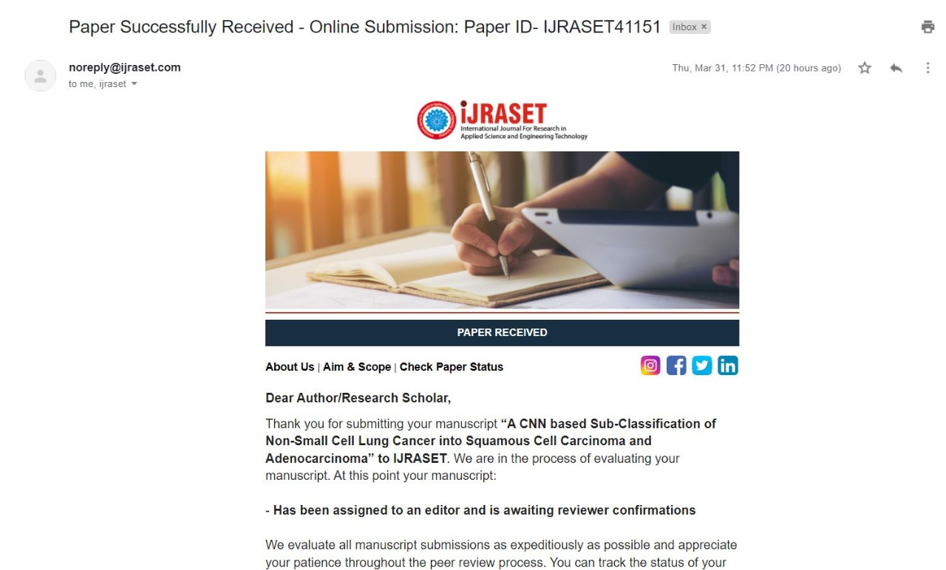
Proof of paper accepted or communicated/ Hackathon/ Patent
Communicated

Slide 9
Motivation to research problem
The following facts motivated us to make this project:
Lung cancer is an important healthcare concern. Men are at greatest risk of dying from this cancer, and women are at second-highest risk.
85 percent of all lung cancer cases are non-small cell lung cancer. Early detection and treatment are important to a patient's recovery.
Diagnosing the various kinds of cancers of the lungs is usually a troublesome process that requires time and error.
And the process of detecting lung cancer is a very time consuming, painful and expensive process.
This detection system will help in identifying the lung cancer subtypes more accurately and in less time and will help to determine patients' right treatment procedures and their survival rates.

Slide 10
Technical Requirements
Minimum Software Requirements -
Tensorflow-GPU Library
Keras API
Jupyter Notebook
Django
MySql Workbench
Minimum Hardware Requirements -
Processor – i5
Hard Disk – 5 GB
GPU - 4 GB
Memory – 4 GB RAM

Slide 11
SDLC Model
As our project has an implementation of machine learning model, so it is performance and accuracy is not fixed and it depends on the dataset and other factors so it is best suited for Agile Methodology.
we can easily manage the changes. As our project has been divided the designing in separate phases for each member like - Frontend, Backend, Machine Learning Model (it is training and testing) and it will be merge together after completion of each phase.

Slide 12
Agile SDLC (Software Development Life Cycle) model is a combination of iterative and incremental process models with focus on process adaptability and customer satisfaction by rapid delivery of working software product.
Agile Methods break the product into small incremental builds. These builds are provided in iterations. Each iteration typically lasts from about one to three weeks. Every iteration involves cross functional teams working simultaneously on various areas like −
Planning
Requirements Analysis
Design
Coding
Testing.

Slide 13
Working/Methodology
The steps of the proposed model can be summarized as follows:
Data preprocessing (LC2500).
Training dataset.
Test and evaluate the model.

Slide 14
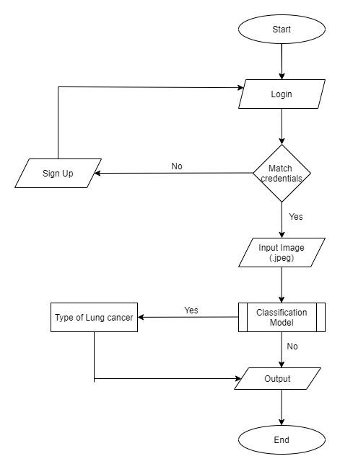
Workflow Diagram

Slide 15
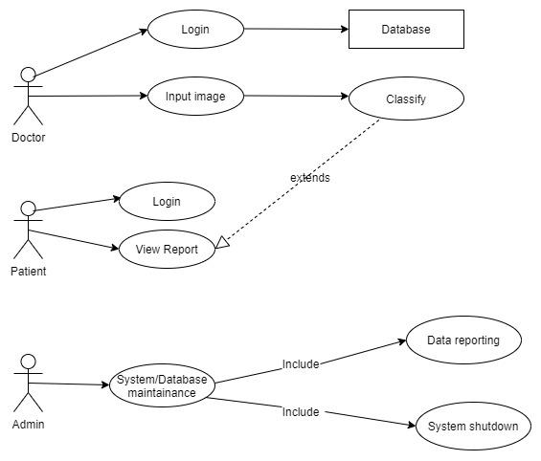
Use Case Diagram

Slide 16
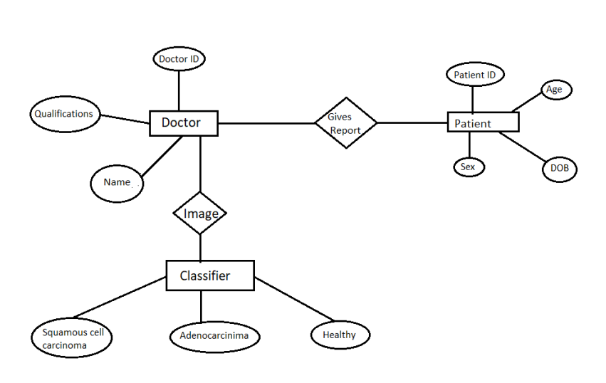
ER - Diagram

Slide 17

GUI

Slide 18
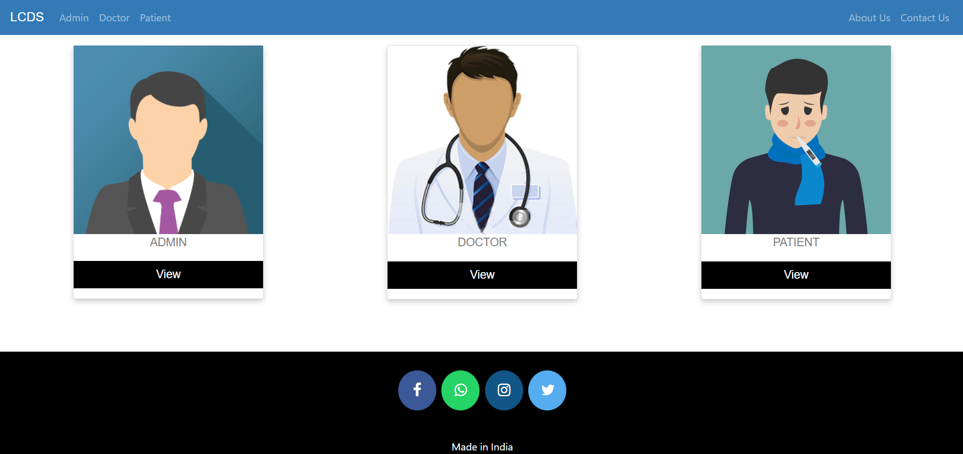

Slide 19
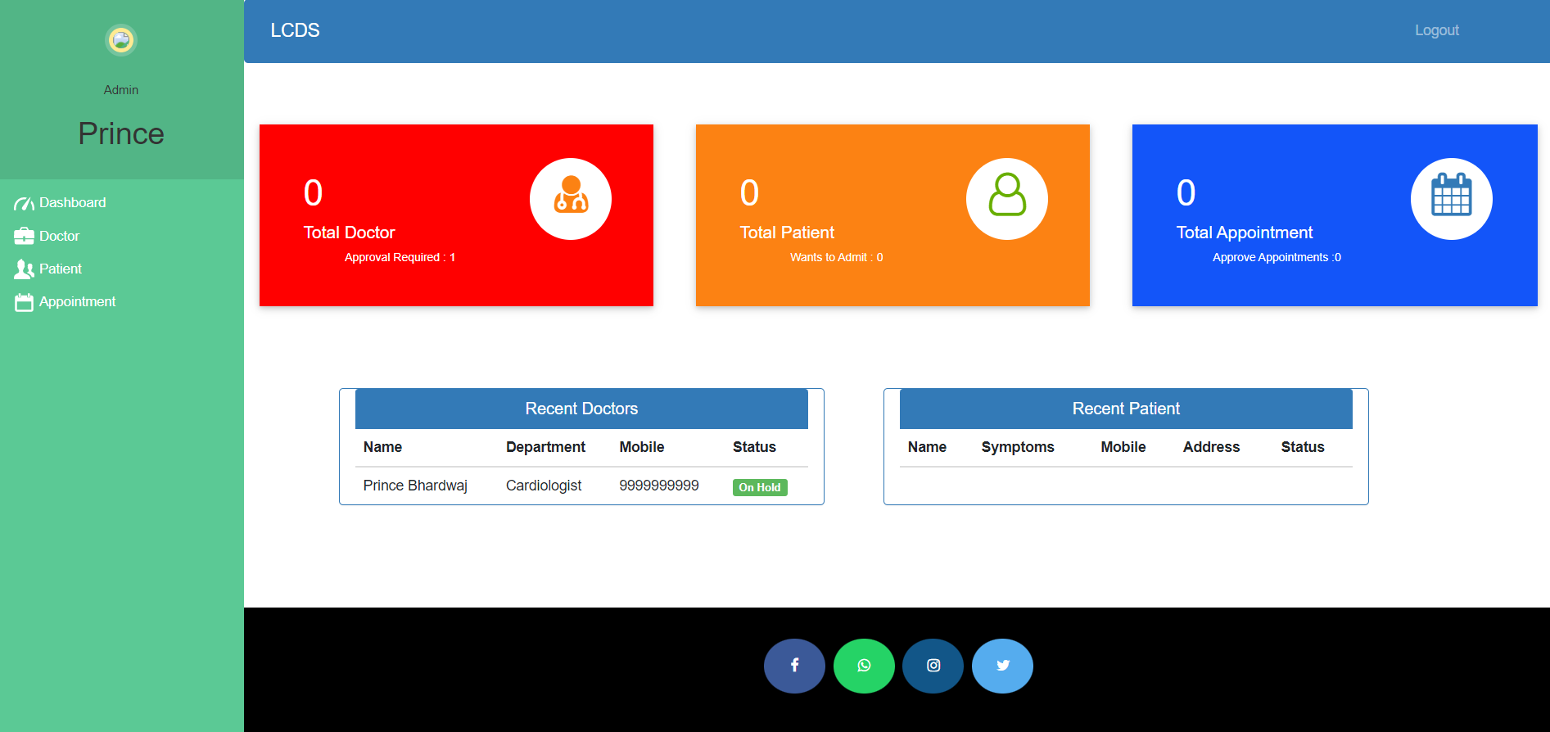

Slide 20
Conclusion
In summary, the trained model is able to classify previously unseen (testing dataset) non-small cell lung carcinoma images into squamous cell carcinoma and adenocarcinoma.

Slide 21
References
[1] Makaju S, Prasad PW, Alsadoon A, Singh AK, Elchouemi A. Lung cancer detection using CT scan images. Procedia Computer Science. 2018 Jan 1;125:107-14.
[2] Asuntha A, Srinivasan A. Deep learning for lung Cancer detection and classification. Multimedia Tools and Applications. 2020 Mar;79(11):7731-62.
[3] Teramoto A, Tsukamoto T, Kiriyama Y, Fujita H. Automated classification of lung cancer types from cytological images using deep convolutional neural networks. BioMed research international. 2017 Aug 13;2017.
[4] Hatuwal BK, Thapa HC. Lung Cancer Detection Using Convolutional Neural Network on Histopathological Images. Int. J. Comput. Trends Technol. 2020;68:21-4.

Slide 22
[5] Tekade R, Rajeswari K. Lung cancer detection and classification using deep learning. In2018 Fourth International Conference on Computing Communication Control and Automation (ICCUBEA) 2018 Aug 16 (pp. 1-5). IEEE.
[6] Khan A. Identification of Lung Cancer Using Convolutional Neural Networks Based Classification. Turkish Journal of Computer and Mathematics Education (TURCOMAT). 2021 Apr 28;12(10):192-203.
[7] Nasrullah N, Sang J, Alam MS, Mateen M, Cai B, Hu H. Automated lung nodule detection and classification using deep learning combined with multiple strategies. Sensors. 2019 Jan;19(17):3722.
[8] Asuntha A, Srinivasan A. Deep learning for lung Cancer detection and classification. Multimedia Tools and Applications. 2020 Mar;79(11):7731-62.
[9] Alakwaa W, Nassef M, Badr A. Lung cancer detection and classification with 3D convolutional neural network (3D-CNN). Lung Cancer. 2017;8(8):409.

Slide 23
[10] Masood A, Sheng B, Yang P, Li P, Li H, Kim J, Feng DD. Automated decision support system for lung cancer detection and classification via enhanced RFCN with multilayer fusion RPN. IEEE Transactions on Industrial Informatics. 2020 Feb 21;16(12):7791-801.
[11] Perumal S, Velmurugan T. Lung cancer detection and classification on CT scan images using enhanced artificial bee colony optimization. International Journal of Engineering & Technology. 2018;7(2.26):74-9.
[12] Zhang C, Sun X, Dang K, Li K, Guo XW, Chang J, Yu ZQ, Huang FY, Wu YS, Liang Z, Liu ZY. Toward an expert level of lung cancer detection and classification using a deep convolutional neural network. The oncologist. 2019 Sep;24(9):1159.
[13] S. Hawkins, H. Wang, Y. Liu, A. Garcia, O. Stringfield, H. Krewer, Q. Li, D. Cherezov, R. A. Gatenby, Y. Balagurunathan, D. Goldgof, M. B. Schabath, L. Hall, and R. J. Gillies, “Predicting malignant nodules from screening ct scans,” Journal of Thoracic Oncology, vol. 11, no. 12, pp. 2120–2128, 2016.
[14] Y. Bar, I. Diamant, L. Wolf, S. Lieberman, E. Konen, and H. Greenspan, “Chest pathology detection using deep learning with non-medical training,” Proceedings - International Symposium on Biomedical Imaging, vol. 2015-July, pp. 294–297, 2015.

Slide 24
[15] J. Tan, Y. Huo, Z. Liang, and L. Li, “A comparison study on the effect of false positive reduction in deep learning based detection for juxtapleural lung nodules: CNN vs DNN,” in Proceedings of the Symposium on Modeling and Simulation in Medicine, MSM ‘17, pp. 8:1–8:8, Society for Computer Simulation International, 2017.
[16] R. Golan, C. Jacob, and J. Denzinger, “Lung nodule detection in ct images using deep convolutional neural networks,” in 2016 International Joint Conference on Neural Networks, pp. 243–250.
[17] D. Kumar, A. Wong, and D. A. Clausi, “Lung nodule classification using deep features in ct images,” in 2015 12th Conference on Computer and Robot Vision, pp. 133–138, June 2015.
[18] A. Chon, N. Balachandar, and P. Lu, “Deep convolutional neural networks for lung cancer detection,” tech. rep., Stanford University, 2017.
[19] W.-J. Choi and T.-S. Choi, “Automated pulmonary nodule detection system in computed tomography images: A hierarchical block classification approach,” Entropy, vol. 15, no. 2, pp. 507–523, 2013.
[20] H. Han, L. Li, H. Wang, H. Zhang, W. Moore, and Z. Liang, “A novel computer-aided detection system for pulmonary nodule identification in CT images,” in Proceedings of SPIE Medical Imaging Conference, vol. 9035, 2014.

